Slide 1
Goal Tracker
Java Jamboree

Slide 2
Purpose
The purpose of this standalone application is to help you move towards a goal (career, educational, personal, or otherwise) in order to keep you from stagnating and becoming a boring lump. It helps you prioritize important activities while avoiding unimportant time-wasting activities.

Slide 3
Important points
Make a goal and use Goal Manager app to fulfil it
Created tasks have an importance and urgency factor, which is used to measure priority
Each day’s tasks are displayed in descending order according to their priority
Tasks of different priority are displayed in different colors (red, orange, yellow, white)
Once created, tasks may be edited or deleted

Slide 4
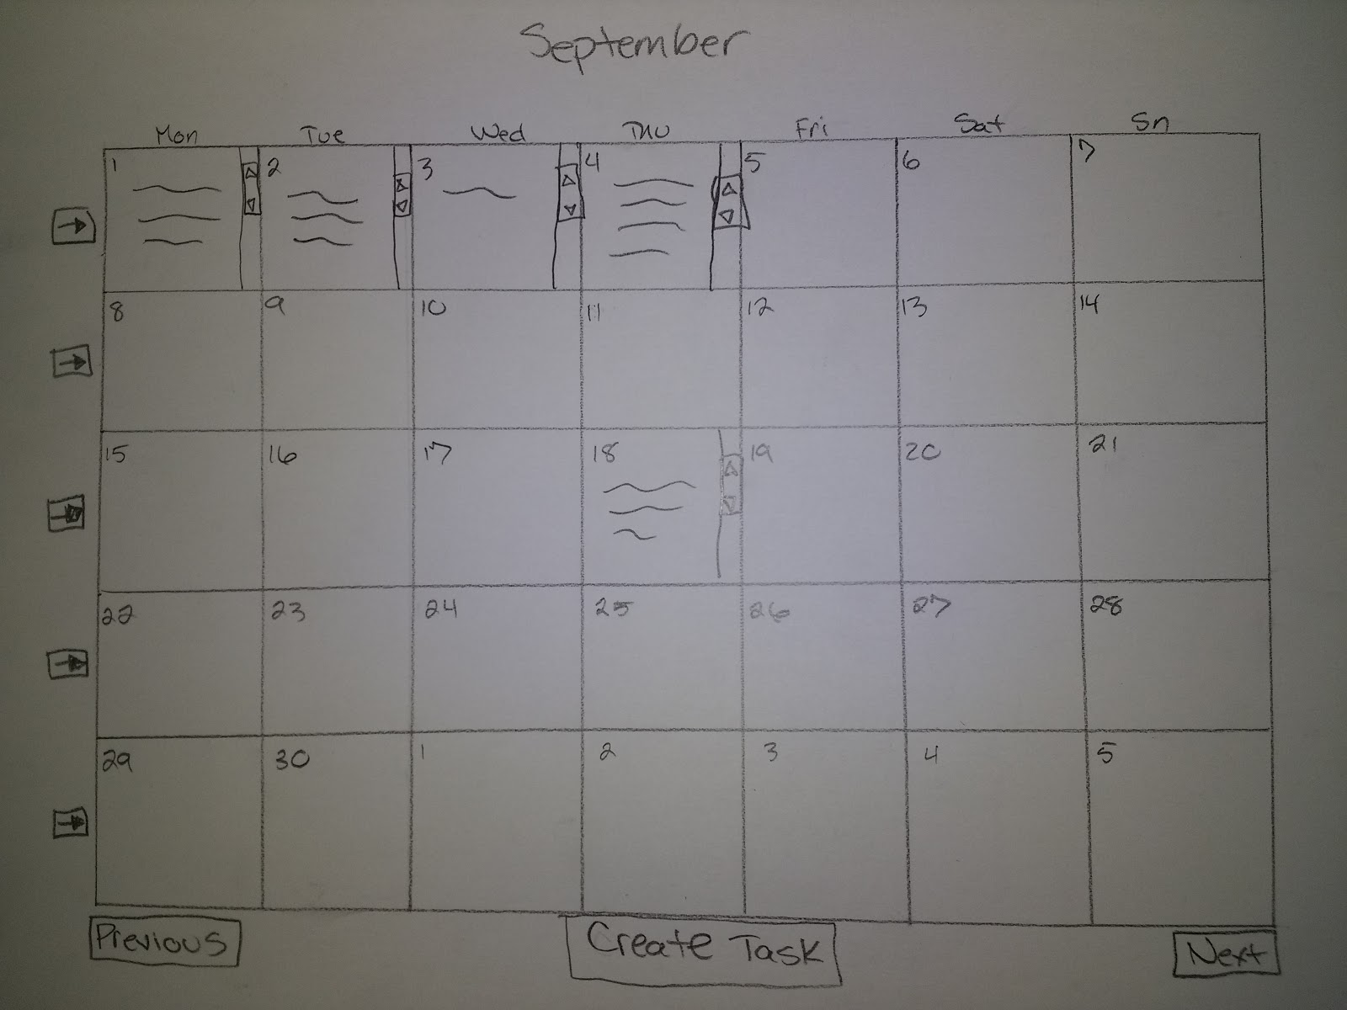
Screen mockups – Month view

Slide 5
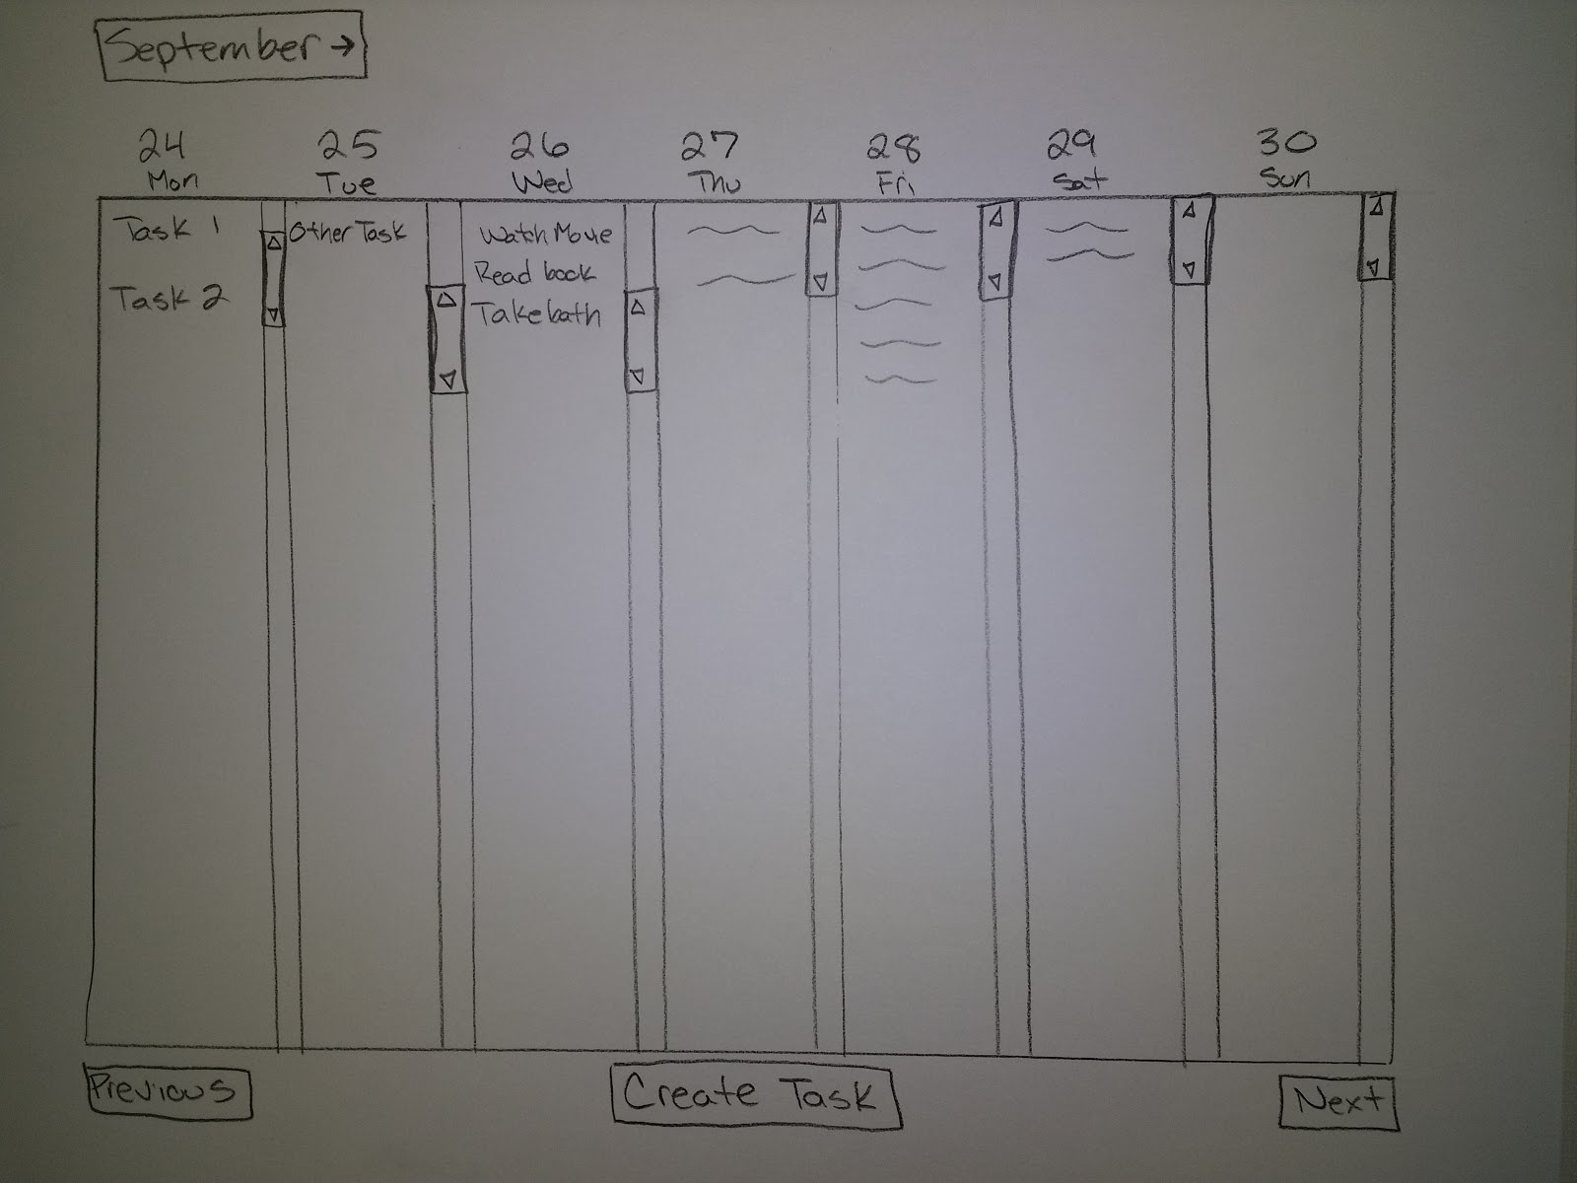
Screen mockups – Week view

Slide 6
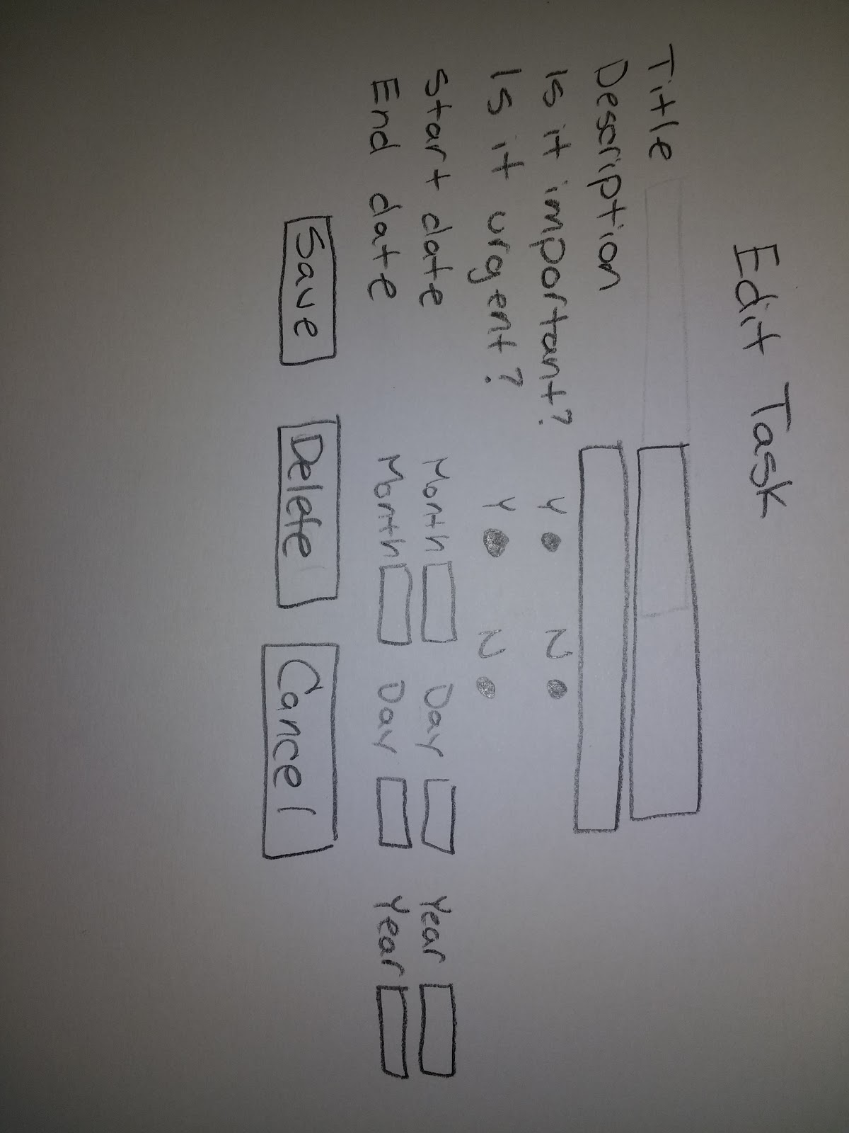
Screen mockups – Task view

Slide 7
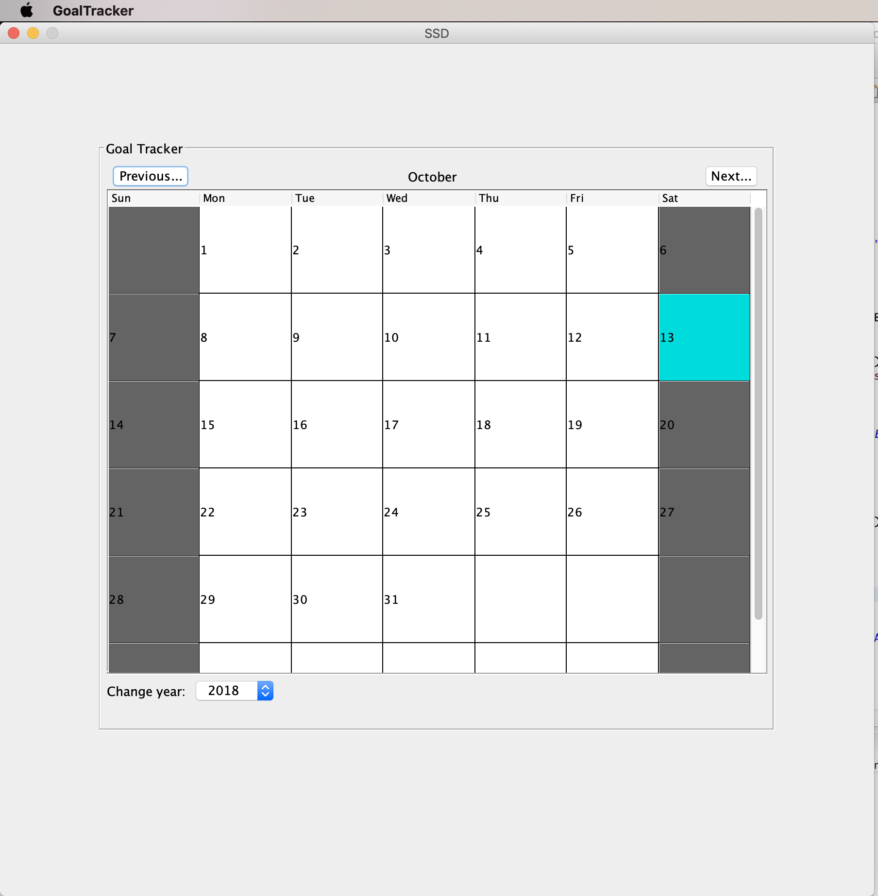
Implemented functionality – Month view

Slide 8
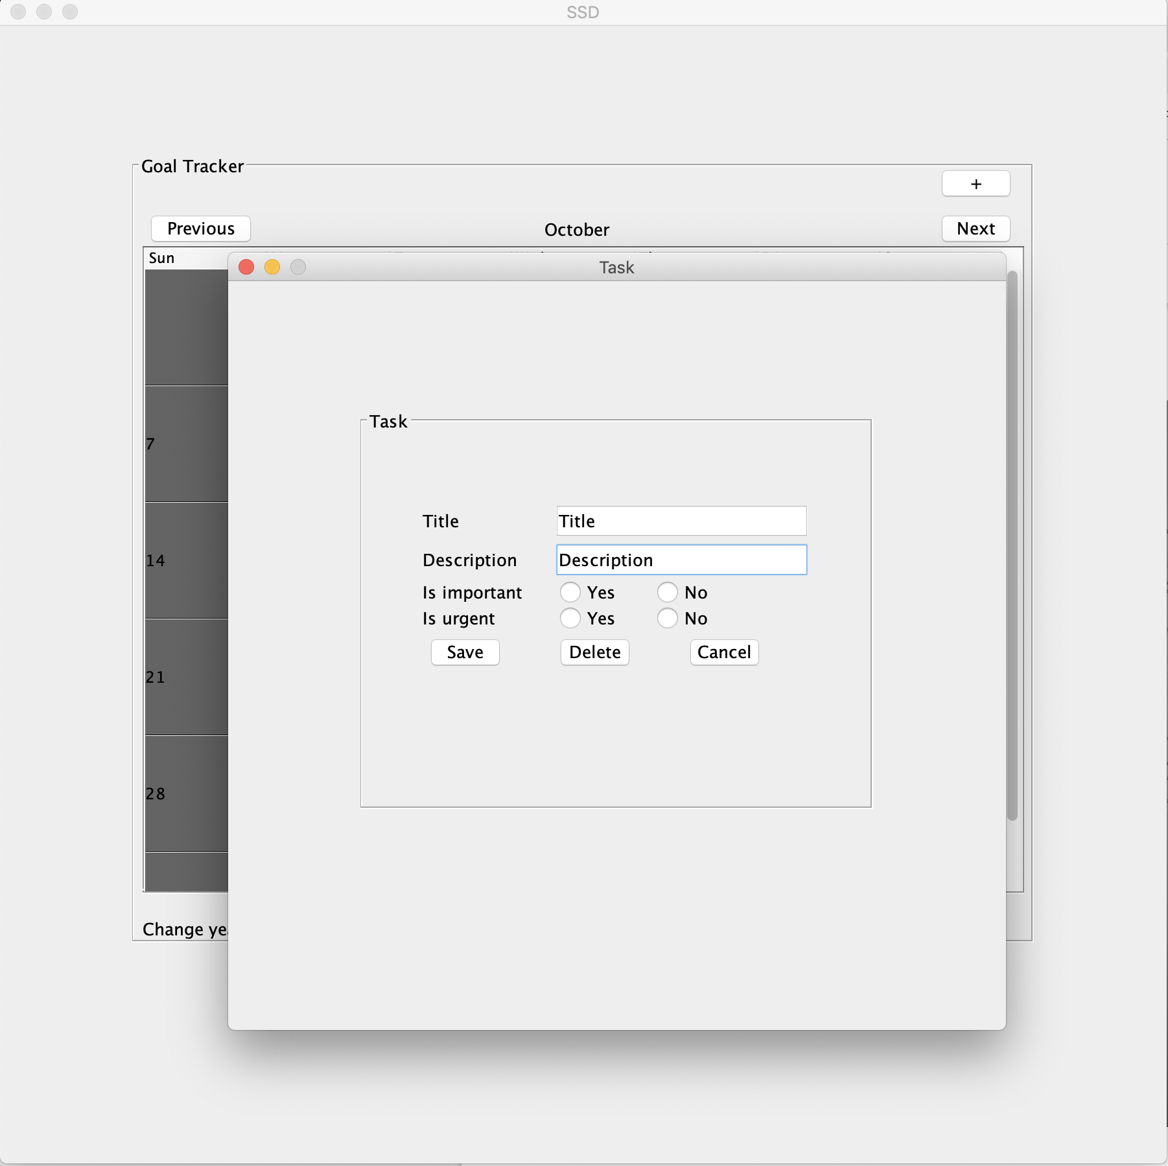
Implemented functionality – Task view

Slide 9

Thank You..

